Slide 1

How Does Air Quality Affect Our Health?

Slide 2
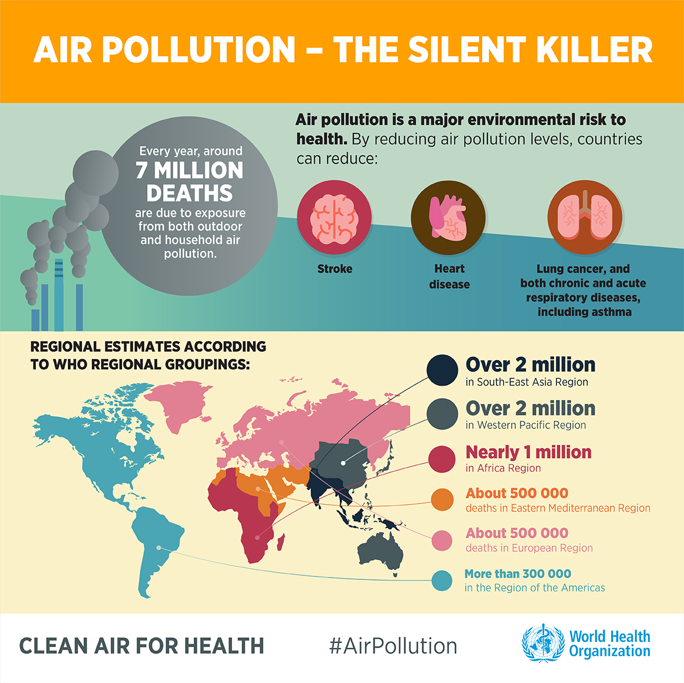
Notes:
https://www.who.int/airpollution/infographics/en/
Discribe related disease here

Slide 3
Goal:
Our goal was to create a site in which users could:
Learn about Air Quality Indicators
Explore the relationship between air quality and health
See current air quality near their homes
Provide contact information for politicians if so inspired

Slide 4

AIR Quality Index (AQI)
AQI reports levels of ozone, particle pollution, and other common air pollutants on the same scale.
The higher the AQI rating, the greater the health impact.
AQI Numbers | AQI Category (Descriptor) | AQI Color
0 - 50 | Good | Green
51 - 100 | Moderate | Yellow
101 - 150 | Unhealthy for Sensitive Groups | Orange
151 - 200 | Unhealthy | Red
201 - 300 | Very Unhealthy | Purple
301 - 500 | Hazardous | Maroon
Notes:
https://docs.airnowapi.org/aq101
Variations in National Air Quality Indexes (AQIs)
Almost every country in the world calculates an Air Quality Index (AQI) - a scale of numbers that represents the current or daily air quality levels in different areas. AQIs are based on local air quality standards and pollutant concentrations, specific to each country.
For example, while in US standards 54 ppb (parts per billion) of Nitrogen Dioxide (NO₂) gas defines moderate air quality (1 hour average), in Israel 250 ppb of NO₂defines the same AQI (30 min average). Moreover while the United States defines six different levels of AQI, Israel defines four, and Hong Kong five (see below).

Slide 5
OUTLINE
Data Process
Data Insights:
Air Quality: Past and Current
Air Quality vs Disease
Solutions
Discussion and Summary

Slide 6
Data Sources
Air Quality:
Annual summary (AQI by CBSA) data from EPA (2001-2018)
Disease:
Most recent data from 500 Cities Project (2016)
Notes:
Disease:
https://chronicdata.cdc.gov/500-Cities/500-Cities-Local-Data-for-Better-Health-2018-relea/6vp6-wxuq
Air:
https://aqs.epa.gov/aqsweb/airdata/download_files.html

Slide 7
Data Process
1. Extract
2. Transform
3. Load
Data source: csv file
Air quality:
Annual data from EPA
Daily data from AirNow API
Disease:
500 Cities Project (CDC Collaboration project)
Air quality:
Delete, rename columns; Merge files; Convert CBSA to cities; Transpose
Disease:
Filter to get city based certain disease data; merge data; Sort to keep top 20 cities for plotting
Load to mySQL db
Set primary key

Slide 8
Our Nation’s Air
1
Where Do We Stand?

Slide 9
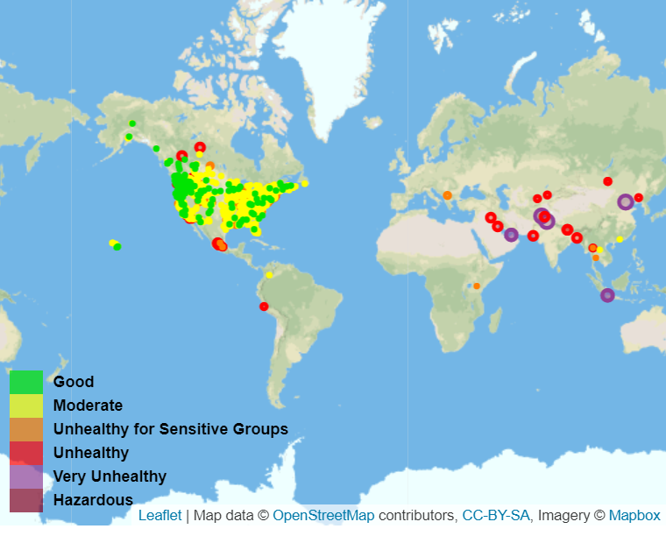

Slide 10
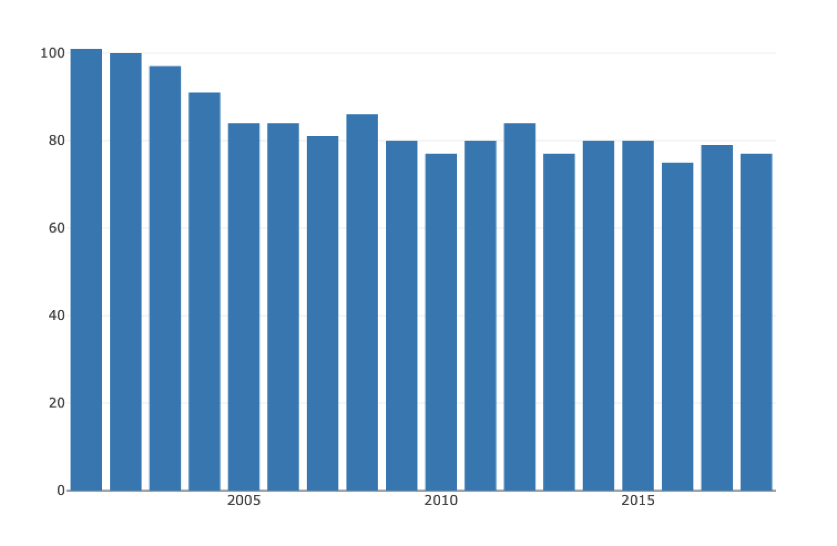
Los Angeles

Slide 11
Air Quality Keep Improving
Our Data Indicates in US:

Slide 12
AIR QUALITY vs DISEASE
2
What does the data tell?

Slide 13
Air Quality vs Disease Prevalence? Data suggests no association in adults groups in US
Asthma
Asthma
COPD
Stroke
Heart disease
Data: US top 20 cities (2016)
Subjects: Adults > 18

Slide 14
Air Quality vs Disease Prevalence? Data suggests no association in adults groups in US
COPD
Asthma
COPD
Stroke
Heart disease
Data: US top 20 cities (2016)
Subjects: Adults > 18

Slide 15
Air Quality vs Disease Prevalence? Data suggests no association in adults groups in US
Stroke
Asthma
COPD
Stroke
Heart disease
Data: US top 20 cities (2016)
Subjects: Adults > 18

Slide 16
Air Quality vs Disease Prevalence? Data suggests no association in adults groups in US
Heart Disease
Asthma
COPD
Stroke
Heart disease
Data: US top 20 cities (2016)
Subjects: Adults > 18

Slide 17

What may affect our results?
New-onset
Disease
Exacerbate of pre-existing Disease
Disease severity,
mortality
Parameters
Analysis by different age groups
World wide data
Age of the Subjects
Air Pollution Level

Slide 18
Summary
3
What did we learn?

Slide 19
SUMMARY
Air Quality: Past and Current
Current: good & moderate
Trend: air quality keep improving since 2001
Air Quality vs Disease
No positive correlation between air quality and disease prevalence (asthma, COPD, stroke and heart disease) in our datasets

Slide 20
Website
Homepage
Heatmap page
Politician page
DEMO
TIME

Slide 21

Thanks!
Any questions?
Presentation template by SlidesCarnival
Photographs by Unsplash

